Slide 1


AI-Guided Econometrics with Stata on WAMZ Data: An Estimation of ARDL on SURE Model
Kimi AI
2025/01/01

Slide 2
CONTENTS
05
04
STATA 11 Code
03
Data
02
Method
01
Theory & Lit
Framing

Slide 3

CONTENTS
Findings
Policy & End

Slide 4


01
Framing

Slide 5

WAMZ Single-Currency Goal
The Gambia
Ghana
The West African Monetary Zone seeks to introduce the Eco as a second regional currency. Rigorous convergence assessment is essential to minimise asymmetric shocks and ensure viability across its six member states.
Guinea, Liberia, Nigeria, Sierra Leone

Slide 6
AI-Econometrics Motive
Traditional methods struggle with complex panel data. AI offers a path to robust, automated analysis.
Manual Specification
AI-Guided Approach
Heterogeneous data
Small samples
Policy diversity
Subjective bias
Automated selection
Enhanced accuracy
Theoretical rigour
Reproducible results

Slide 7
Research Objectives
Develop AI-guided ARDL-SURE framework
Examine 2000-2023 convergence patterns
Assess monetary-union feasibility
Demonstrate STATA 11 implementation
Deliver evidence-based policy guidance for West African integration

Slide 8
02
Theory & Lit

Slide 9
Optimum Currency Area
The theoretical benchmark by Mundell, McKinnon, and Kenen outlines pre-conditions for a viable currency union, guiding WAMZ's evaluation.
Symmetric Shocks
Factor Mobility
Inflation Convergence
Fiscal Discipline
Exchange-Rate Stability

Slide 10
Empirical Evidence
Fiscal Divergence
Inflation Sync
Sporadic Compliance
Agbeyegbe (2008) highlights persistent fiscal imbalances across ECOWAS.
Rana (2007) notes limited synchronization of inflation patterns.
ECOWAS reports show only sporadic achievement of convergence targets.
Conclusion: A need for deeper coordination and rigorous empirical monitoring.

Slide 11
03
Method

Slide 12
1. Data Preprocessing
AI-Guided Workflow
2. ML Variable Selection
A five-step pipeline to automate and enhance econometric analysis, reducing bias and improving reproducibility.
3. Lag Optimization (AIC/BIC)
4. Automated Diagnostics
5. NLP Interpretation

Slide 13

ARDL Equation
Captures within-country short- and long-run dynamics for each WAMZ member, allowing for mixed I(0)/I(1) variables.

Slide 14
SURE System
Jointly estimates equations across countries, exploiting cross-equation error correlations to improve efficiency and capture spillovers.

Slide 15
Variable Definitions
Primary Criteria
Secondary Criteria
INF: Inflation rate ≤ 5%
DEBTGDP: Debt / GDP ≤ 70%
BDGDP: Budget deficit / GDP ≤ 3%
CBFIN: Central bank financing ≤ 10%
RESIMP: External reserves / Imports ≥ 3 months
EXRVOL: Exchange rate volatility ±10%

Slide 16
04
Data

Slide 17


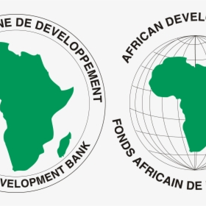


Sample Description
Annual 2000–2023 panel data for six WAMZ countries, sourced from reputable international and regional institutions.
World Bank WDI
IMF IFS
AfDB
ECOWAS
Central Banks

Slide 18
Descriptive Statistics Highlights
Country | Mean INF (%) | Mean RESIMP (months) | Fiscal Volatility
Ghana | 12.4 | 2.8 | High
Guinea | 15.2 | 1.4 | Medium
Nigeria | 11.8 | 6.5 | Medium
Liberia | 8.9 | 2.9 | High
Cross-country heterogeneity confirms partial convergence and need for differentiated policy tracks.

Slide 19
Descriptive Highlights
Highest Inflation
Strongest Reserves
Most Fiscal Volatility
Ghana & Guinea
Nigeria
Liberia & Ghana
Conclusion: Significant cross-country heterogeneity confirms partial convergence.

Slide 20
05
STATA 11 Code

Slide 21
STATA 11 Setup & Panel Declare
* Set working directory and load data cd "C:\WAMZ_Analysis" use "WAMZ_Convergence_Data.dta", clear * Declare panel xtset country_id year, yearly * Generate time trend gen time_trend = year - 2000 tabulate country, gen(country_dum) // country dummies
Note: Verify `country_id` alignment and variable names before proceeding.

Slide 22
AI Lag Search
* Install ARDL package capture ssc install ardl, replace * Lag search via information criteria ardl inf bdgdp resimp debtgdp cbfin exrvol, maxlag(4) aic ardl inf bdgdp resimp debtgdp cbfin exrvol, maxlag(4) bic ardl inf bdgdp resimp debtgdp cbfin exrvol, maxlag(4) hqic // ML-guided selection
AI-assisted selection via AIC, BIC, and HQIC for optimal model specification.

Slide 23
Unit Root Tests
* Install PP test ssc install pperron foreach var of varlist inf bdgdp resimp debtgdp cbfin exrvol { di "ADF & PP tests for `var'" dfuller `var', lags(1) trend pperron `var', trend }
Result: All series are I(1), confirming the appropriateness of the ARDL approach.

Slide 24
Country ARDL Loop
* Loop over countries levelsof country, local(cty) foreach c of local cty { preserve keep if country=="`c'" ardl inf bdgdp resimp debtgdp cbfin exrvol, maxlag(2 2 2 2 2 2) ec estimates store ardl_`c' ardlbounds restore }
Estimates long- and short-run coefficients for each member state.

Slide 25
SURE Estimation
* Reshape to wide form reshape wide inf bdgdp resimp debtgdp cbfin exrvol, i(year) j(country_id) * Estimate SURE system sureg (inf1 bdgdp1 resimp1) (inf2 bdgdp2 resimp2) (inf3 bdgdp3 resimp3) /// (inf4 bdgdp4 resimp4) (inf5 bdgdp5 resimp5) (inf6 bdgdp6 resimp6), corr small dfk
Jointly estimates equations to account for cross-country error correlations.

Slide 26
Post-Estimation Diagnostics
xttest3 // heteroskedasticity xtserial inf bdgdp resimp debtgdp cbfin exrvol // serial corr xtcsd, pesaran // cross-dependence estat correlation // SURE residual corr
Confirms model stability and validates the SURE specification.

Slide 27
06
Findings

Slide 28
Unit Root & Cointegration
ADF & PP Tests
ARDL Bounds Test
All variables are I(1)
F-stats > I(1) bound
Integrated of order one
for all countries
Conclusion: Long-run equilibrium relationships exist. ✓

Slide 29
Long-Run Coefficients
Fiscal Deficit → Inflation
Reserves → Inflation
+
-
A positive and significant nexus across all members.
A negative link, indicating a stabilizing effect.
Key Insight: Fiscal discipline and reserve adequacy are crucial for price stability.

Slide 30
SURE Pooled Results
Parameter | Coefficient | Significance
BDGDP → INF | 0.456 | ***
RESIMP → INF | -0.298 | ***
DEBTGDP → INF | 0.123 | ***
CBFIN → INF | 0.087 | **
EXRVOL → INF | 0.234 | ***
*** ppan>

Slide 31
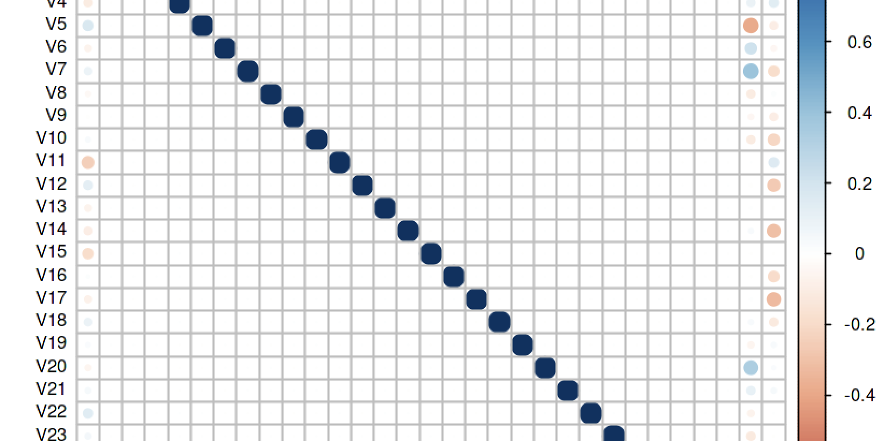
Cross-Equation Correlation Matrix
Average correlation ≈ 0.67, indicating strong interdependence. Low values for fragile states (e.g., Guinea) suggest heterogeneous shock transmission.

Slide 32
Convergence Compliance (2000–2023)
Country | Primary % | Secondary % | Overall %
Nigeria | 72.7 | 59.1 | 66.9
The Gambia | 68.2 | 45.5 | 56.8
Ghana | 54.5 | 36.4 | 45.5
Sierra Leone | 50.0 | 31.8 | 40.9
Liberia | 40.9 | 27.3 | 34.1
Guinea | 31.8 | 22.7 | 27.3
Average | 53.0 | 37.1 | 45.1

Slide 33

Convergence Compliance
Overall convergence compliance across WAMZ averages 45%, with primary criteria compliance at 53% and secondary criteria at 37%.
Nigeria leads with 66% compliance, while Guinea lags at 27%, reflecting significant heterogeneity in macroeconomic performance and policy outcomes.
The results indicate partial convergence, suggesting progress but highlighting persistent disparities and the need for further policy coordination.
Overall Compliance
Country Performance
Partial Convergence

Slide 34
07
Policy & End

Slide 35
Policy Roadmap
Fiscal Council
Monetary Coordination
Stabilization Fund
AI Surveillance
Phased Eco Entry
A phased, multi-pronged approach to manage heterogeneity and sustain integration momentum.

Slide 36

Fiscal Coordination
Monetary Policy Coordination
Establish a WAMZ Fiscal Council to enforce fiscal discipline, coordinate budget deficit targets, and ensure transparent public financial management across member states.
Develop a joint monetary policy framework focused on inflation targeting and exchange rate stability, leveraging Nigeria's leadership role for regional coordination.
External Reserve Management
AI-Based Monitoring
Policy Roadmap
Create a Regional Stabilization Fund or Reserve Pooling Mechanism to enhance collective financial resilience and mitigate external shocks.
Invest in AI-driven economic surveillance systems to continuously monitor macroeconomic indicators and provide early warnings for policy adjustments.

Slide 37
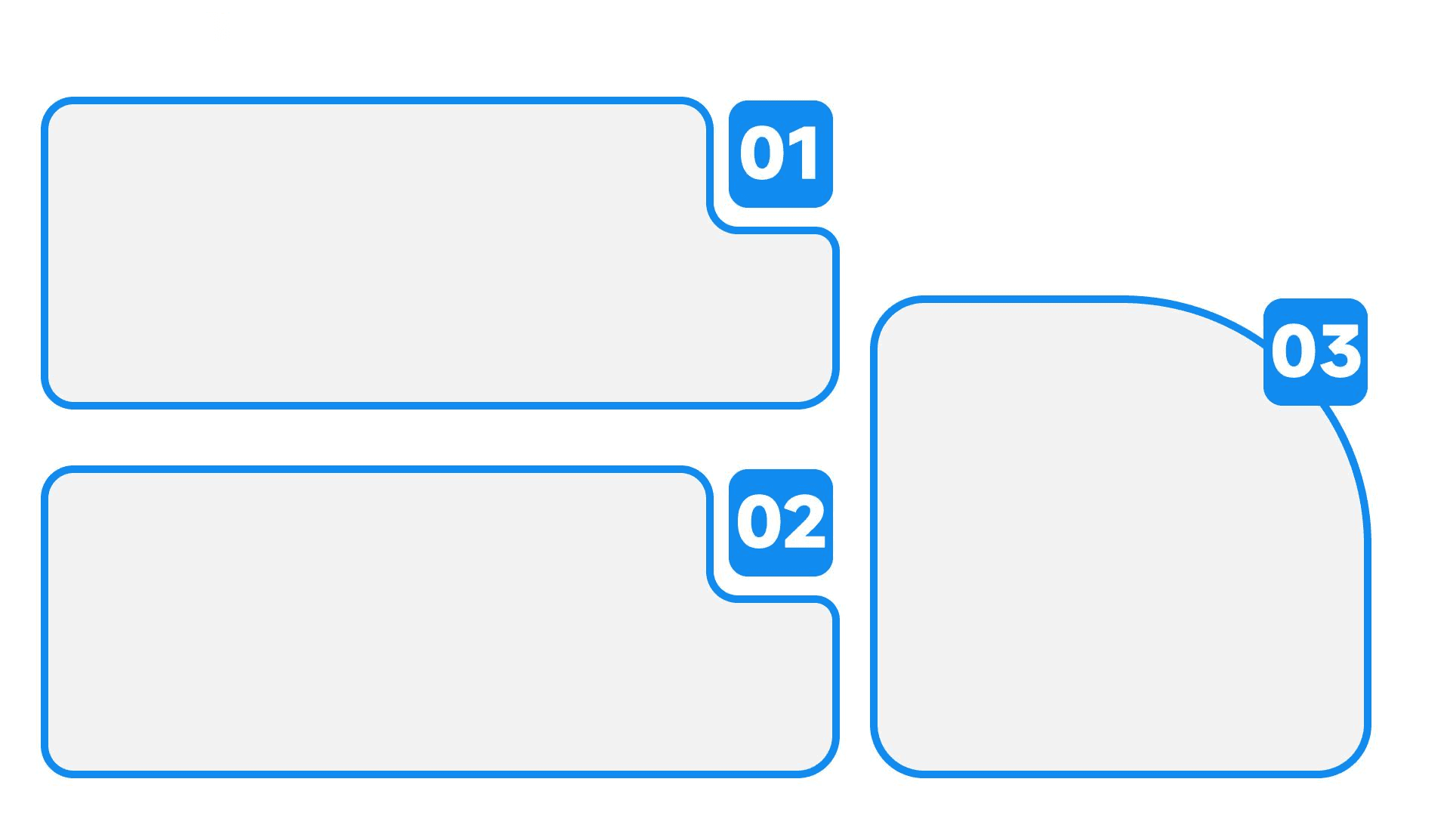
Robustness & Limits
Robustness Checks
Alternative lag specifications, subsample analysis, and comparison with fixed effects, random effects, and GMM estimators confirm the robustness and reliability of the study's findings.
Future Research
Study Limitations
Future work could incorporate Bayesian extensions, high-frequency data, and institutional quality metrics to further refine the analysis and enhance policy relevance.
Limitations include data gaps, potential structural breaks due to global crises, and the emphasis of machine learning algorithms on statistical fit over theoretical coherence.

Slide 38
Robustness & Limits
Future Work
✓ Robustness
Integrate Bayesian methods for uncertainty modeling.
Incorporate higher-frequency data and governance indicators.
Develop hybrid Python-STATA pipelines for advanced ML.
Focus on network spillover analysis and real-time dashboards.
Stable results across alternative lags and estimators (FE/RE/GMM).
Consistent findings in sub-sample analyses.
⚠ Limitations
Possible data gaps and structural breaks.
ML prioritizes fit, which may diverge from theory.

Slide 39

Study Conclusions
The study confirms long-run convergence but incomplete harmonization across WAMZ countries, highlighting the central role of fiscal and external variables in ensuring macroeconomic stability.
Policy Recommendations
Conclusion & Next Steps
Sustained coordination, technological integration, and phased reforms are essential for successful Eco launch and durable West African monetary union. Future research should focus on real-time monitoring and institutional indicators.

Slide 40

Conclusion & Next Steps
WAMZ shows long-run convergence but incomplete harmonisation. Fiscal and external variables are central to stability.
AI-guided econometrics offers scalable, data-driven policy tools.
Sustained coordination, institutional reforms, and phased integration are key to a successful Eco launch.

Slide 41


THANK
YOU
Kimi AI
2025/01/01

